Slide 1

SMART INDIA HACKATHON 2026
Problem Statement ID – 26103
Problem Statement Title- Use case on web-based integrated project-monitoring platform
Theme- Smart Automation
PS Category- Software
Team ID-
Team Name – Tech Panther

Slide 2
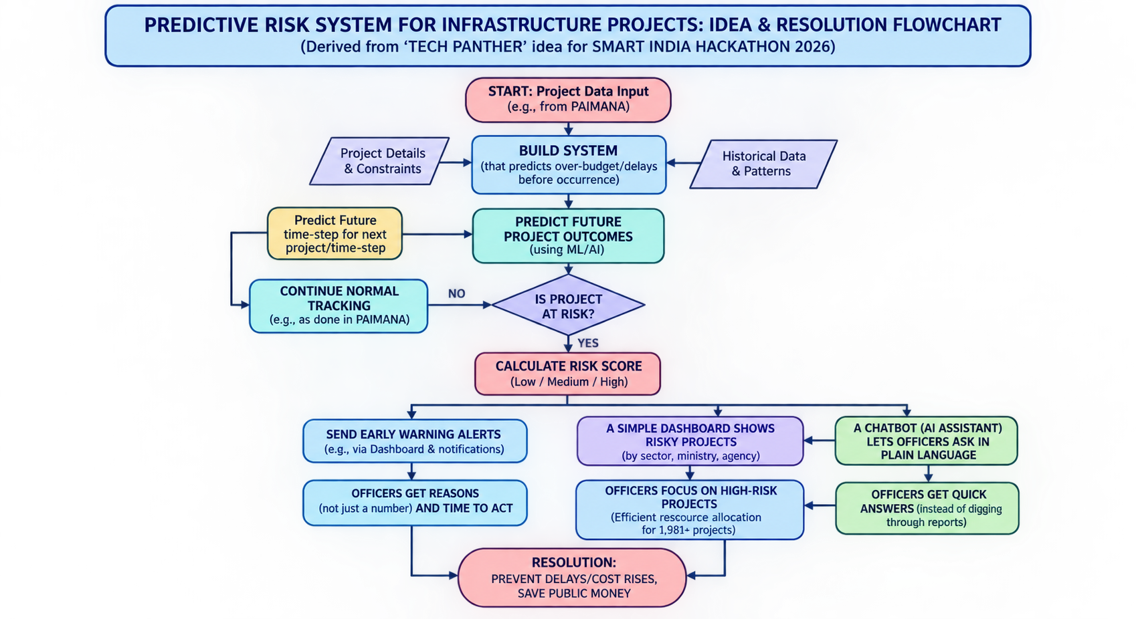
Tech
Panthers
IDEA TITLE
Idea/Solution
Build a system that predicts which projects will go over budget or get delayed, before it actually happens..
Give every project a risk score (Low / Medium / High) so officers know where to look first.
Send early warning alerts when a project starts showing warning signs, like slow progress or rising cost.
A simple dashboard shows risky projects by sector, ministry and agency.
A chatbot (AI assistant) lets officers ask in plain language, like "Which road projects are likely to be delayed?”
Problem Resolution
Our system tells what will likely happen.
Predicts what is likely to happen.
Provides early alerts before costs rise.
Prioritizes high-risk projects for officers.
Explains the reasons behind delays and cost increases.
Provides quick answers through a chatbot.
Saves public money and delivers assets sooner.
Unique Value Propositions (UVP)
Predicts, not just reports: Identifies future risks early.
100% Open-Source: Low cost with no vendor lock-in.
Explainable AI: Shows the key reasons behind each risk score.
Proven AI Value: Compares AI with traditional statistical methods.
Identifies Data Gaps: Suggests missing fields for CUF improvement.
Easy to Use: Simple chatbot and dashboard for all officers.
PAIMANA Integration: Uses monthly data and APIs for continuous learning.

Slide 3
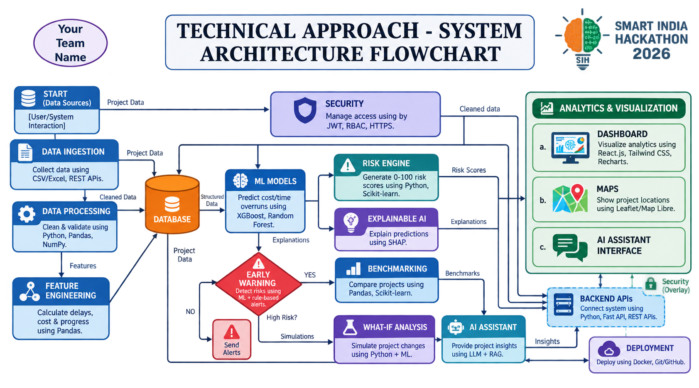
TECHNICAL APPROACH
Tech
Panthers
Data Ingestion – Collect data using CSV/Excel, REST APIs.
Data Processing – Clean & validate using Python, Pandas, NumPy.
Feature Engineering – Calculate delays, cost & progress using Pandas.
Database – Store project data in PostgreSQL, SQL.
ML Models – Predict cost/time overruns using XG Boost, Random Forest.
Risk Engine – Generate 0–100 risk scores using Python, Scikit-learn.
Explainable AI – Explain predictions using SHAP.
Early Warning – Detect risks using ML + rule-based alerts.
Benchmarking – Compare projects using Pandas, Scikit-learn.
What-If Analysis – Simulate project changes using Python + ML.
AI Assistant – Provide project insights using LLM + RAG.
Dashboard – Visualize analytics using React.js, Tailwind CSS, Recharts.
Maps – Show project locations using Leaflet/Map Libre.
Backend APIs – Connect system using Python, Fast API, REST APIs.
Security – Manage access using JWT, RBAC, HTTPS.
Deployment – Deploy using Docker, Git/GitHub.

Slide 4
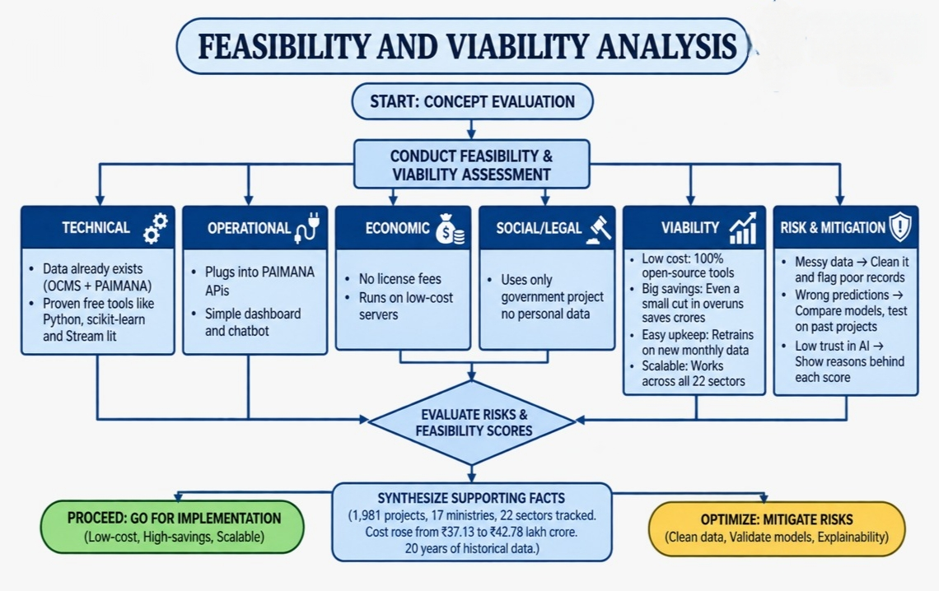
FEASIBILITY AND VIABILITY
Tech
Panthers
Technical: Data already exists (OCMS + PAIMANA). Proven free tools like Python, scikit-learn and Stream lit.
Operational: Plugs into PAIMANA APIs. Simple dashboard and chatbot.
Economic: No license fees. Runs on low-cost servers.
Social/Legal: Uses only government project data, no personal data.
Viability
Low cost: 100% open-source tools.
Big savings: Even a small cut in overruns saves crores.
Easy upkeep: Retrains on new monthly data.
Scalable: Works across all 22 sectors.
Risk and Mitigation
Messy data → Clean it and flag poor records.
Wrong predictions → Compare models, test on past projects.
Low trust in AI → Show reasons behind each score.
Supporting Facts
1,981 projects, 17 ministries, 22 sectors tracked.
Cost rose from ₹37.13 to ₹42.78 lakh crore (about 15% extra).
20 years of historical data ready to use.

Slide 5
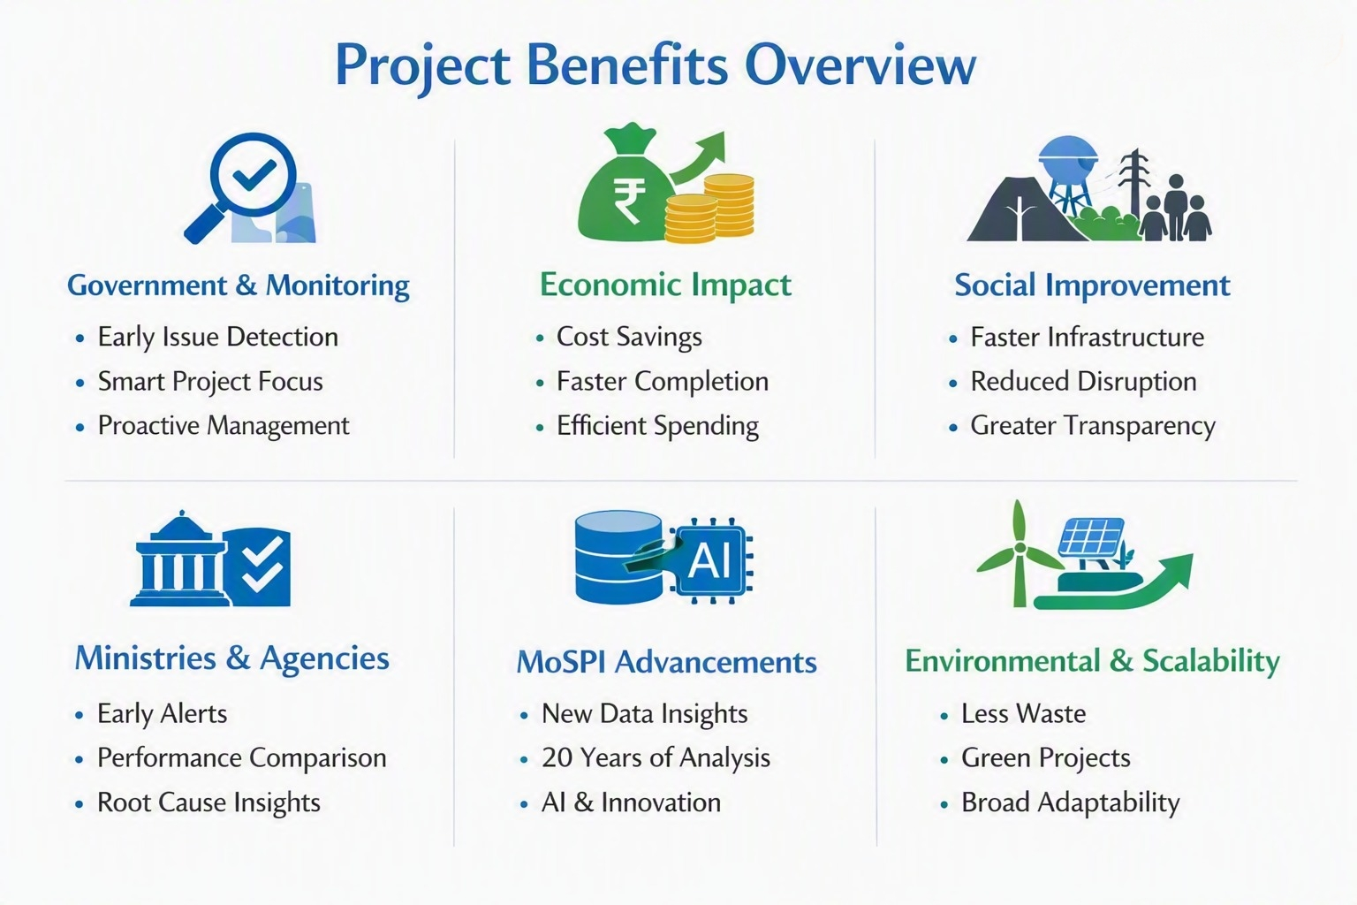
IMPACT AND BENEFITS
Tech
Panthers
🌐 Government / Monitoring Impact
Problems detected early, avoiding cost and delay escalation
Officers prioritize projects effectively with limited staff/time
Data‑driven decisions replace guesswork
Monitoring shifts from reactive reporting to proactive prevention
💰 Economic Benefits
Saves public money by reducing cost overruns on mega projects
Faster completion reduces cost escalation and accelerates returns
Low operating cost due to open‑source tools
Improves future budget and fund planning
👥 Social Benefits
Citizens receive infrastructure (roads, railways, water, power) sooner
Timely project completion reduces community disruption
Greater transparency and accountability in public projects
🏢 Benefits for Ministries & Agencies
Early alerts help resolve land, contractor, or approval issues
Benchmarking enables cross‑sector project comparisons
Clear reasons for delays/cost rise prevent repeat mistakes
📊 Benefits for MoSPI
Identifies new CUF fields for better predictions
Utilizes 20 years of OCMS and PAIMANA data
Tests AI vs. traditional statistics for future tech decisions
🌱 Environmental Benefits
Reduced delays minimize wasted materials, idle machinery, and rework
Faster delivery of clean energy, water, and transport projects
📈 Scalability
Applicable across 22 sectors and 17 ministries in PAIMANA
Extendable to state‑level and smaller projects (< ₹150 crore)
Improves continuously with new monthly data
Reusable by other departments tracking large projects

Slide 6
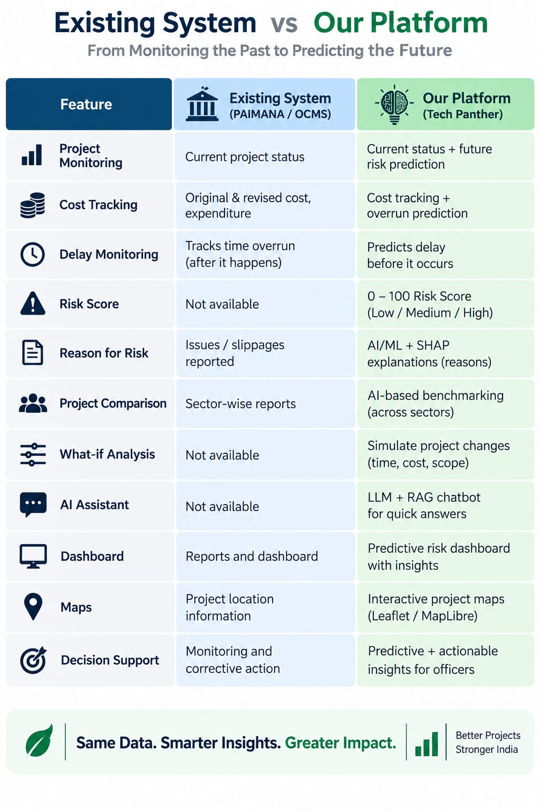
RESEARCH AND REFERENCES
Tech
Panthers
PAIMANA / OCMS : Studied existing Government project-monitoring system and available project data.
Data Analysis: Reviewed project cost, progress, expenditure, delay and completion parameters.
Research Gap: Existing monitoring mainly reports current/past status; our solution adds predictive risk analysis.
ML Research: Random Forest & XG Boost studied for predicting cost and time overruns.
Explainable AI: SHAP used to identify the major factors behind each prediction.
Risk & Alerts: Research supports combining ML predictions + rule-based thresholds for early warnings.
Decision Support: Benchmarking, What-if analysis and AI/RAG assistant convert predictions into actionable insights.
Technology Research: Python, Pandas, Scikit-learn, PostgreSQL, Fast API and React/Tailwind selected based on suitability and scalability.
References : MoSPI – PAIMANA / IPMDOCMS Project Monitoring PAIMANA Public Dashboard Research papers on ML-based project delay & cost prediction Research on SHAP / Explainable AI

